Slide 1
What is GEMINI?
And why should I care?
Peter Parslow, AGI & OS

Slide 2
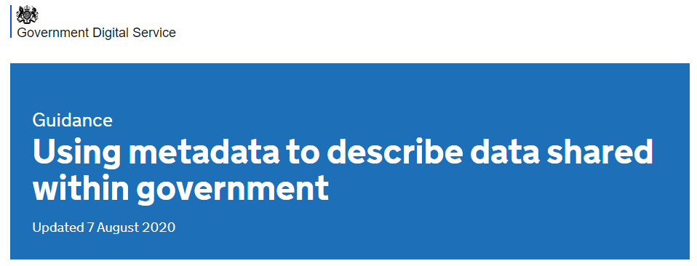
What’s “geographic”?
“any data with a direct or indirect reference to a specific location or geographical area.”
“You should not use Dublin Core if you’re:
creating and managing geographic data - use documentation in INSPIRE, specifically the section on GEMINI”
Follow the link to get data.gov.uk guidance on “harvesting” INSPIRE metadata….
“GEMINI and ISO 19139 metadata
The CSW/WAF/Single-File harvesters all require the records to be in either GEMINI or ISO 19139 format, depending on whether the data is (geo-)spatial or not. Use:
ISO 19139 for non-spatial data
GEMINI 2.3 for spatial data (including INSPIRE datasets)”
Notes:
Right at the bottom of the guidance
The “INSPIRE” link (https://guidance.data.gov.uk/publish_and_manage_data/harvest_or_add_data/inspire/)

Slide 3
Why did they say that?
“harvesting” INSPIRE metadata to data.gov.uk….
INSPIRE: a statutory instrument* that’s part of the “UK Spatial Data Infrastructure”. Obliges
Secretary of State for the Environment to set up a discovery service
“making it possible to search for spatial data sets and spatial data services on the basis of the content of the corresponding metadata and to display the content of the metadata”
all public authorities to catalogue their datasets (and web services)
Uses data.gov.uk
GEMINI has been the agreed standard for that since 2009
* 2009, amended a lot; overseen by the ICO; equivalent SI in Scotland

Slide 4
Is it still a good idea? What is GEMINI?
GEMINI | UK | Association for Geographic Information
ISO 19115:2003 Geographic information – Metadata | Worldwide | ISO
Dublin Core | Worldwide
GEMINI | UK | Association for Geographic Information
GEMINI | UK | Association for Geographic Information
ISO 19115:2003 Geographic information – Metadata | Worldwide | ISO
Strongly influenced by INSPIRE Technical Guidelines
Notes:
GEMINI builds on ISO 19115 in a way that’s strongly influenced by INSPIRE

Slide 5
So what’s in GEMINI?
Title | And alternative titles
Abstract
Keywords | Controlled & uncontrolled
Dates | Date range of data, dates of publication, revision
Point(s) of contact | Publisher, creator, ….
Lineage | Where did it come from? How has it been processed?
Geographic extent | Bounding box
Links | To information, download, licences,…
Conformity | To standards or specification
Quality | A whole range of options: Precision, completeness, accuracy,
Maintenance info | e.g. frequency of update
And some ‘control’ stuff: metadata date, creator contact details, UUID metadata identifier….
Notes:
The usual stuff….

Slide 6
Who uses it?
Approximately half the records in data.gov.uk
Over 300 metadata organisations (2017 count)
Local authorities
Central government bodies (RPA, Defra, MMO, EA,…)
Arms length bodies (OS, BGS, UKHO, Met Office, police, Natural England, Highways Authority, CEFAS, BODC, …)
Scottish Government
Natural Resources Wales
Universities, NERC
Companies

Slide 7
Tools
GEMINI – UK specific
Online
UK Location Metadata Editor
Scottish SDI
Offline – server
GeoNetwork Open Source
ESRI ArcGIS
Offline – “desktop”
MEDIN metadata maestro
World – ISO 19115 editors
US
Federal Geographic Data Commission
EPA
OSGeo (open source):
16 at https://wiki.osgeo.org/wiki/Metadata_software
eENVPlus (EEA)
ArcGIS Pro
….

